Slide 1

Predict London Temperature
Lakhvir Singh

Slide 2
Dataset: (10 featured columns)
Working with data stored in london_weather.csv, which contains the following columns:
date - recorded date of measurement - (int)
cloud_cover - cloud cover measurement in oktas - (float)
sunshine - sunshine measurement in hours (hrs) - (float)
global_radiation - irradiance measurement in Watt per square meter (W/m2) - (float)
max_temp - maximum temperature recorded in degrees Celsius (°C) - (float)
mean_temp - mean temperature in degrees Celsius (°C) - (float)
min_temp - minimum temperature recorded in degrees Celsius (°C) - (float)
precipitation - precipitation measurement in millimeters (mm) - (float)
pressure - pressure measurement in Pascals (Pa) - (float)
snow_depth - snow depth measurement in centimeters (cm) - (float)

Slide 3
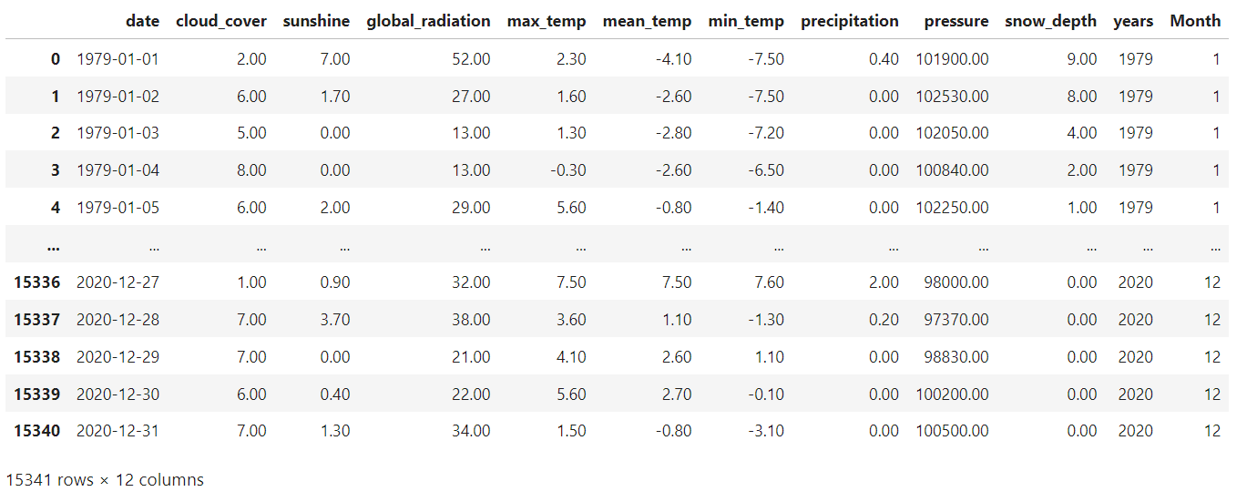
Extract years and month column from date

Slide 4
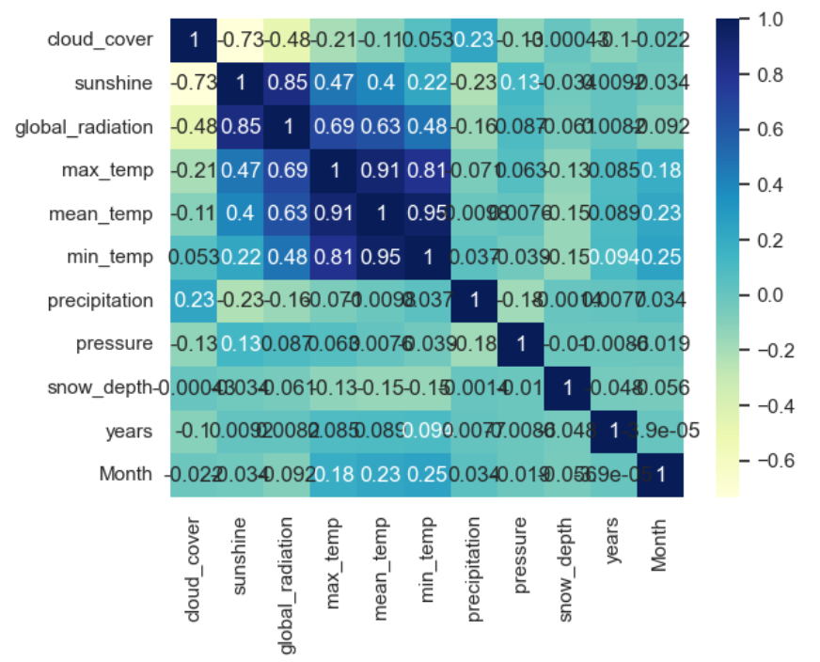
Correlation Matrix:

Slide 5
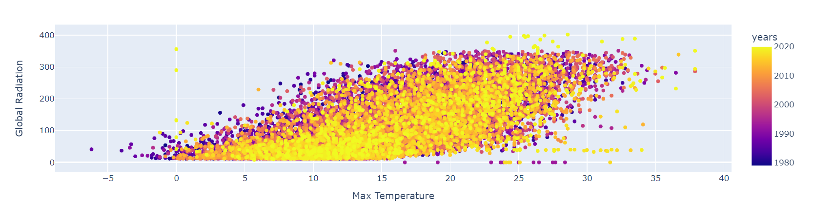
"Scatter Plot of Max Temperature vs. Global Radiation in London Over the Years"

Slide 6
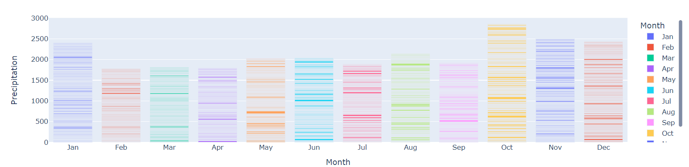
"Monthly Precipitation in London: Bar Chart"

Slide 7

How does sunshine vary by month and year in London

Slide 8
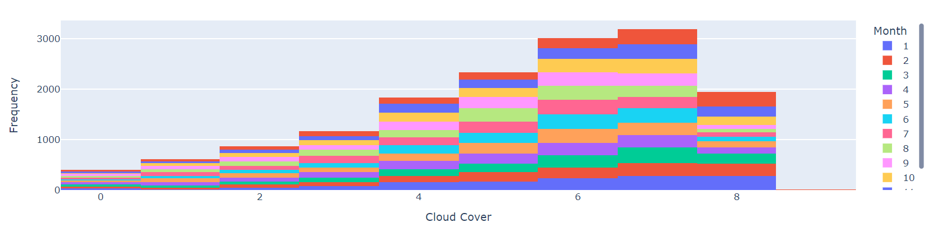
"Cloud Cover Distribution in London: Histogram

Slide 9
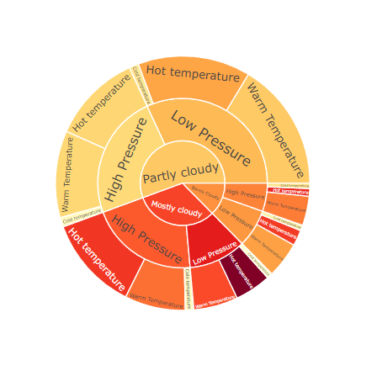
"London Weather Data by Categories: Sunburst Chart"

Slide 10
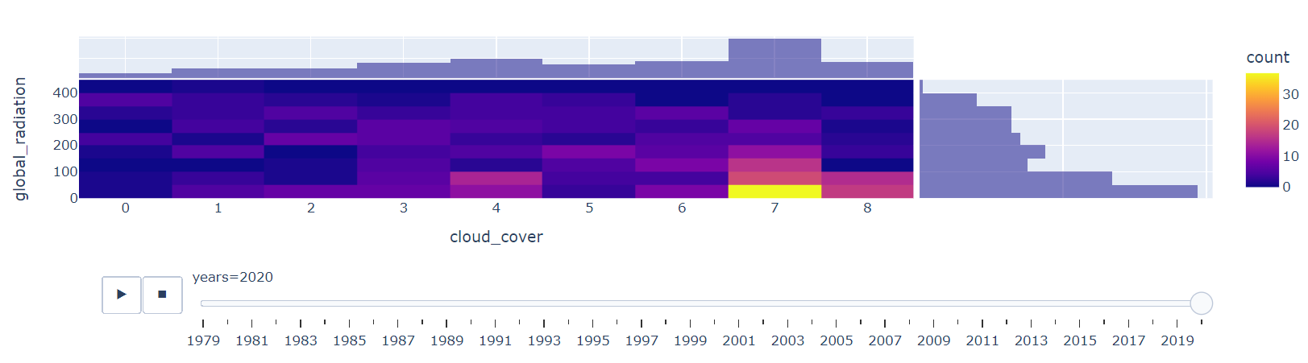
"Cloud Cover vs. Global Radiation Over Time: Density Heatmap"

Slide 11
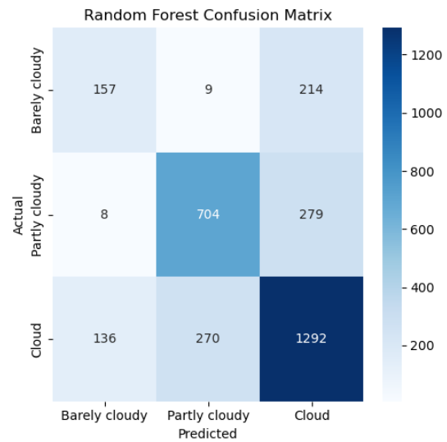
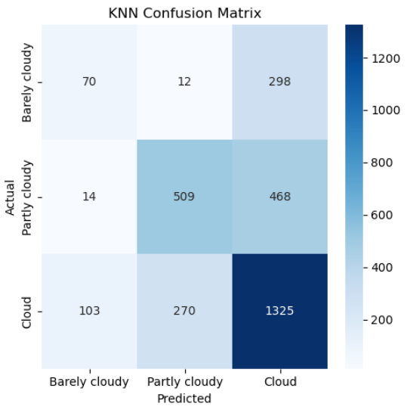
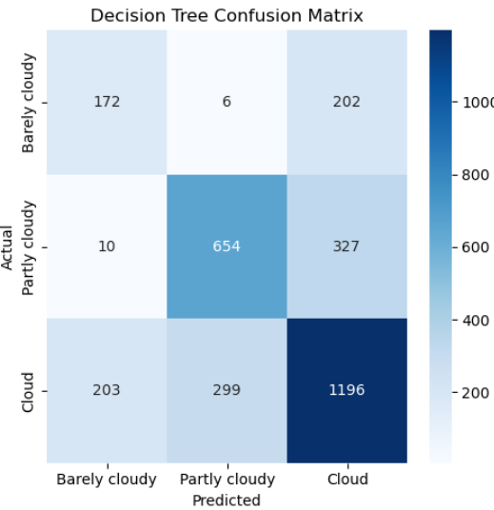
"Comparison of Confusion Matrices for Machine Learning Models"

Slide 12
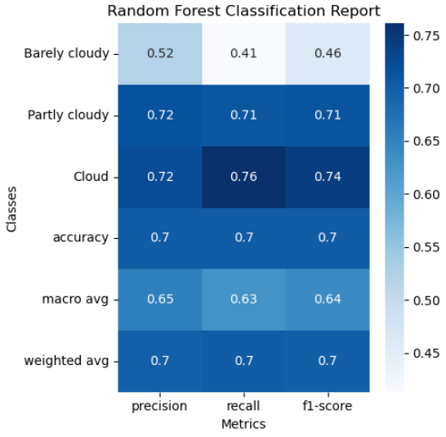
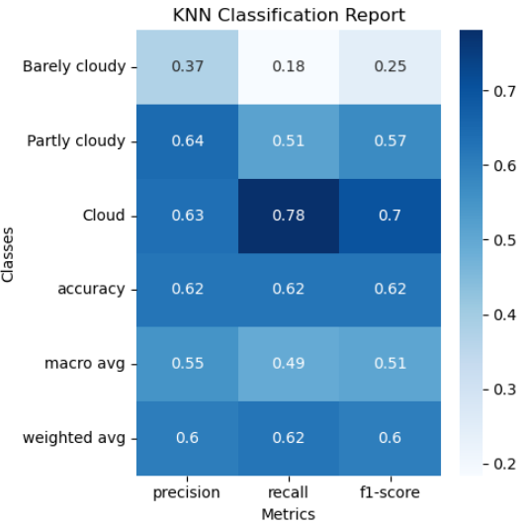
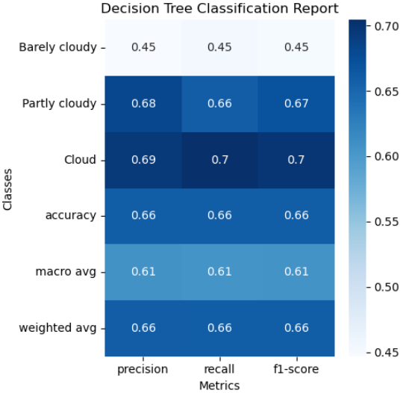
Classification Reports:

Slide 13
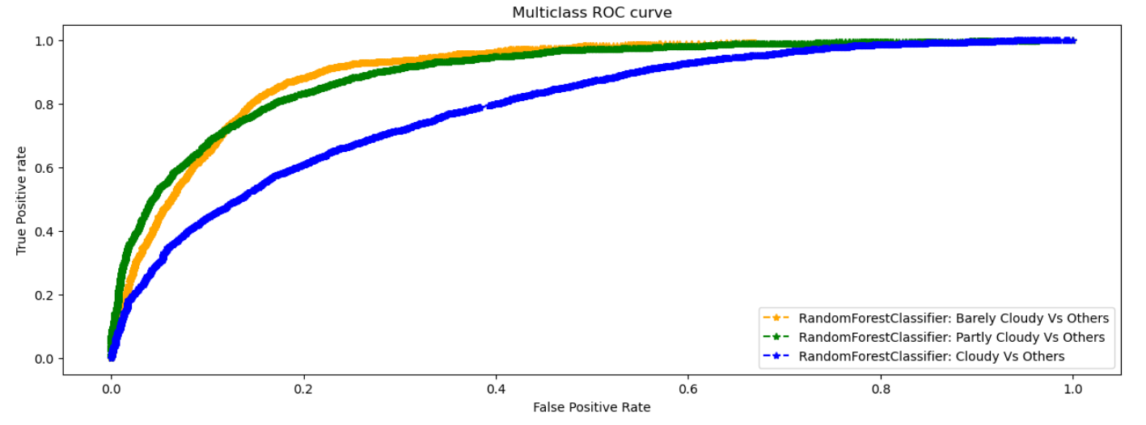
RandomForestClassifier ROC:

Slide 14
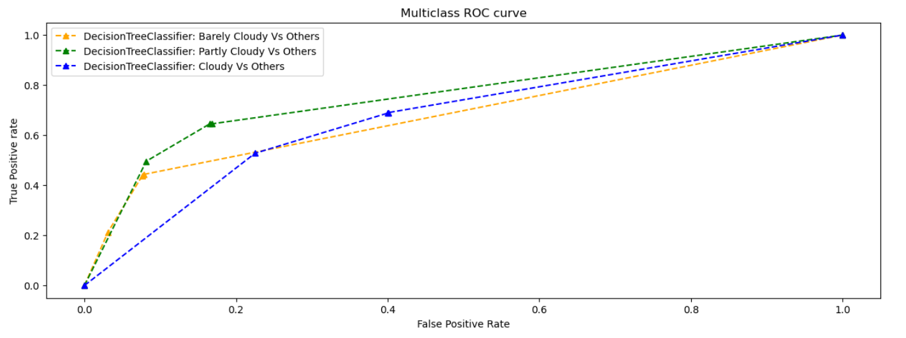
DecisionTreeClassifier ROC:

Slide 15
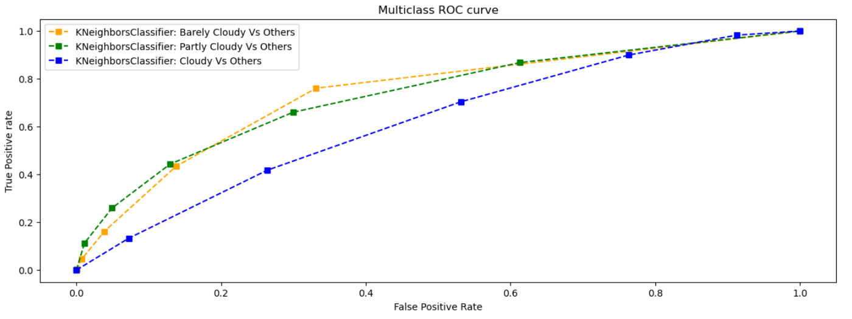
KNeighboursClassifier:

Slide 16
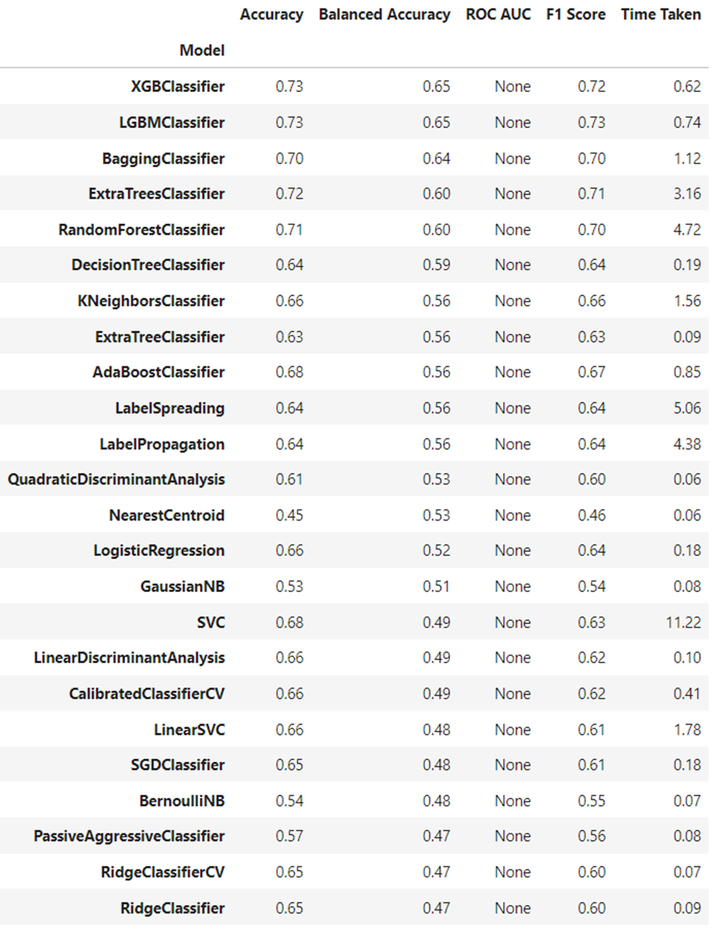
Lazy Predict:

Slide 17

Thank You

